Slide 1



The Influence of Confirmation Bias and Social Influence on the Forming of Majority Opinions in social networks
Tobias Beers
Ben Dickens
Mannus Schomaker
Atke Visser
Dirk Zomerdijk

Slide 2
Definitions (wiki)
Confirmation Bias (Similarity)
… is the tendency to search for, interpret, favor, and recall information in a way that confirms one's preexisting beliefs or hypotheses.
Social influence (Coupling Coëfficient)
occurs when a person's emotions, opinions or behaviors are affected by others intentionally or unintentionally.

Slide 3
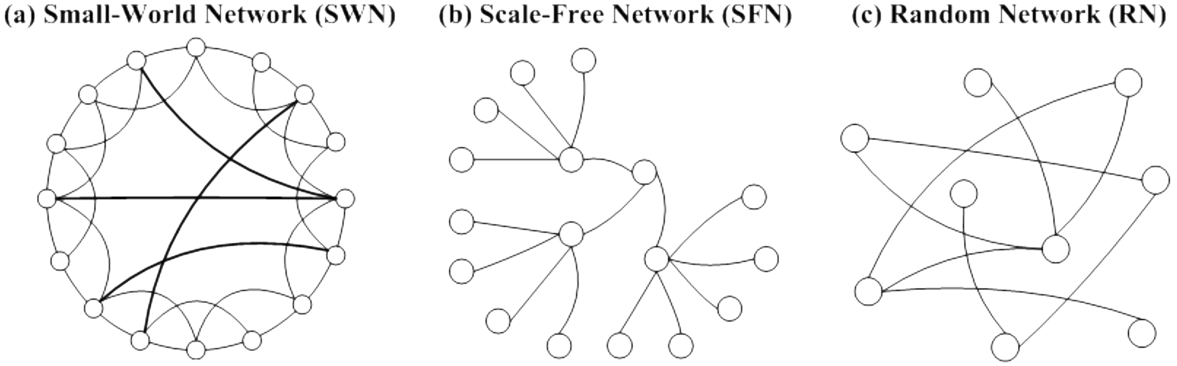
Environment
Network:
Small-World
Scale Free
Random
Node: Agent
Edge: Trust [0,1]

Slide 4
Agent
Agent
Opinion (0, 1)
Preference [0, 1]

Slide 5
Behaviour
Agent
Talks to Neighbors
Selects Neighbors (Similar, Trust)
Forms opinion
Updates Trust

Slide 6
Talk (Select Neighbors)
Selects Neighbors
Similarity
Trust
Forms opinion
Choose Opinion
Calculate new Preference
Updates Trust
Select Neighbors
Similarity (~.025)
Opinion & Preference
B
A
.82
C
Opinion
.61
.37
A
.8
B
.1
.3
.20

Slide 7
Talk (Select Neighbors)
Selects Neighbors
Similarity
Trust
Forms opinion
Choose Opinion
Calculate new Preference
Updates Trust
Select Neighbors
Similarity (~.025)
Opinion & Preference
Trust
Probability
B
A
.8
C
Opinion
.6
.3
A
.8
B
.1
.3
.2

Slide 8
Talk (Select Neighbors)
Selects Neighbors
Similarity
Trust
Forms opinion
Choose Opinion
Calculate new Preference
Updates Trust
Select Neighbors
Similarity (~.025)
Opinion & Preference
Trust
Probability
B
A
.8
C
Opinion
.6
.3
A
.8
B
.3
.2

Slide 9
Talk (Form Opinion)
Selects Neighbors
Similarity
Trust
Forms opinion
Choose Opinion
Calculate new Preference
Updates Trust
Form Opinion

Slide 10
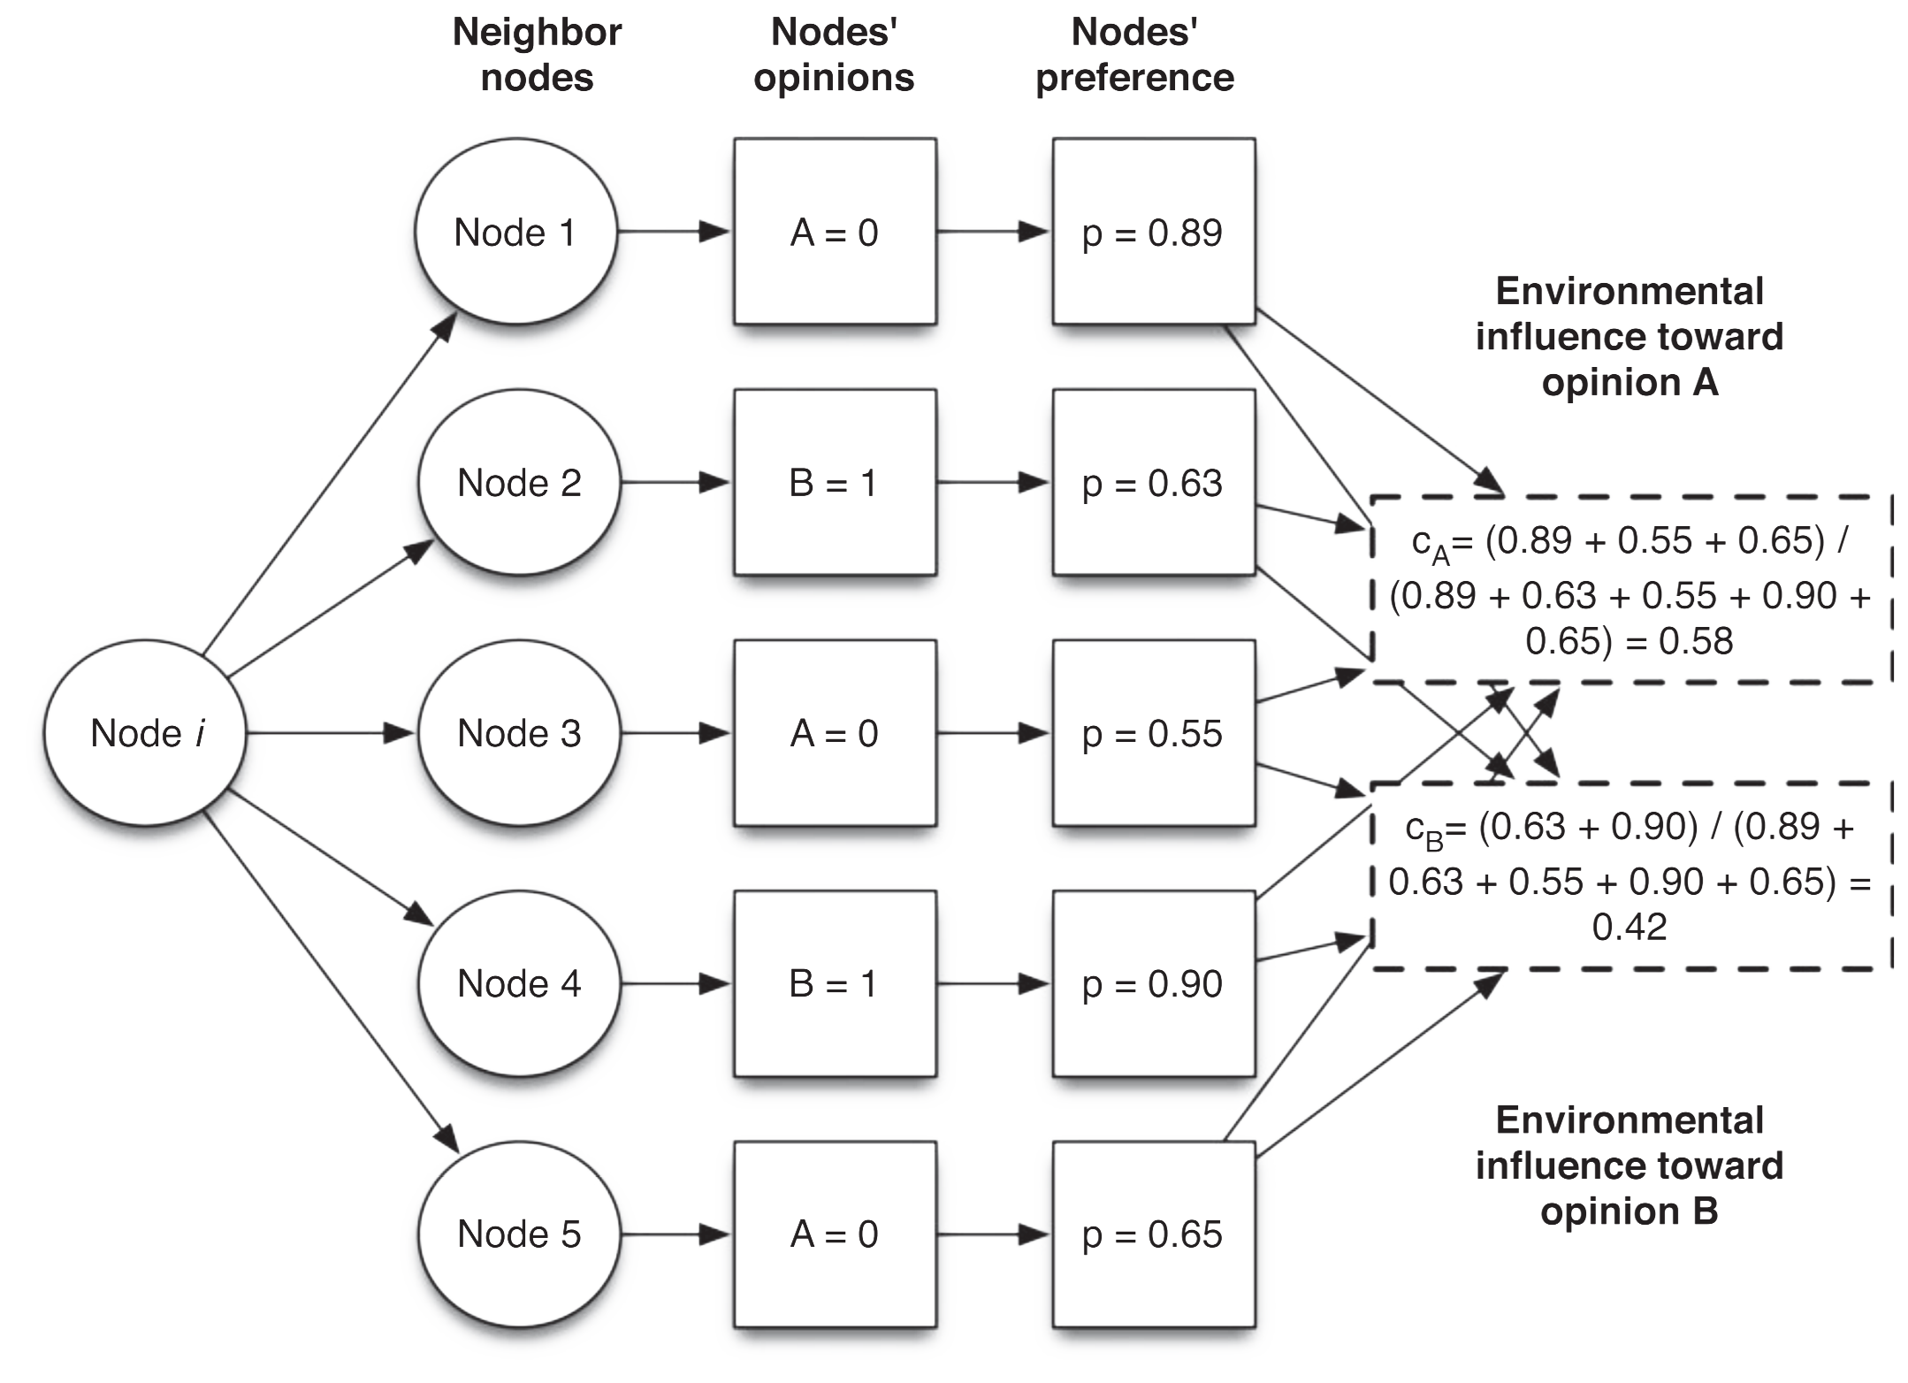
Talk (Form Opinion)
Selects Neighbors
Similarity
Trust
Forms opinion
Choose Opinion
Calculate new Preference
Updates Trust
Form Opinion
Alvarez-Galvez, J. (2016). Network models of minority opinion spreading: using agent-based modeling to study possible scenarios of social contagion. Social Science Computer Review, 34(5), 567-581.

Slide 11
Talk (Form Opinion)
Selects Neighbors
Similarity
Trust
Forms opinion
Choose Opinion
Calculate new Preference
Updates Trust
Form Opinion
Probability A (.58) and B (.42)
Choose A or B ?
Alvarez-Galvez, J. (2016). Network models of minority opinion spreading: using agent-based modeling to study possible scenarios of social contagion. Social Science Computer Review, 34(5), 567-581.

Slide 12
Talk (Form Opinion)
Selects Neighbors
Similarity
Trust
Forms opinion
Choose Opinion
Calculate new Preference
Updates Trust
Form Opinion
Confidence Bound
Probability A ( .58 ) and B ( .42 )
Own Opinion? (B)
Own Preference? (.31)
If (Probability A > Preference for B):
Choose A or B based on probability
Calculate new preference
.31

Slide 13
Talk (Form Opinion)
Selects Neighbors
Similarity
Trust
Forms opinion
Choose Opinion
Calculate new Preference
Updates Trust
Form Opinion
Probability A ( .58 ) and B ( .42 )
Own Opinion? (B)
Own Preference? (.31)
If (Probability A > Preference for B):
Choose A or B based on probability
Calculate new preference

Slide 14
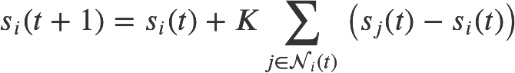
Talk (Calculate new preference)
Selects Neighbors
Similarity
Trust
Forms opinion
Choose Opinion
Calculate new Preference
Updates Trust
Form Opinion
Calculate new preference (s_{i})
Coupling Coefficient K: Social Influence (~0.01)
Starnini, M., Frasca, M., & Baronchelli, A. (2016). Emergence of metapopulations and echo chambers in mobile agents. Scientific reports, 6, 31834.

Slide 15
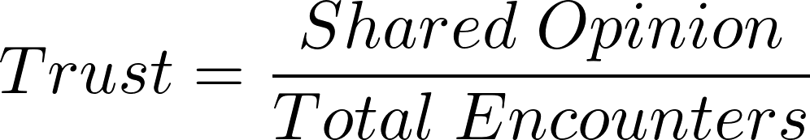
Talk (Update Trust)
Selects Neighbors
Similarity
Trust
Forms opinion
Choose Opinion
Calculate new Preference
Updates Trust
B
Update Trust of Selected Neighbors
A
.8
C
Opinion
.6
.3
A
.7 ↑
B
.4 ↓
.2

Slide 16
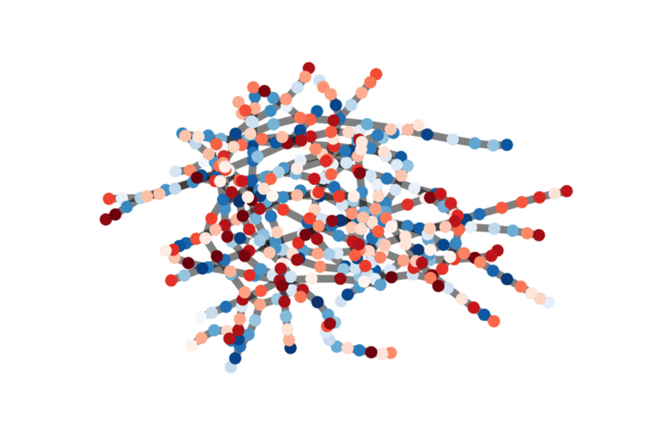
Stylized Facts
Majority Opinion
Echo Chambers
Malicious Agents

Slide 17
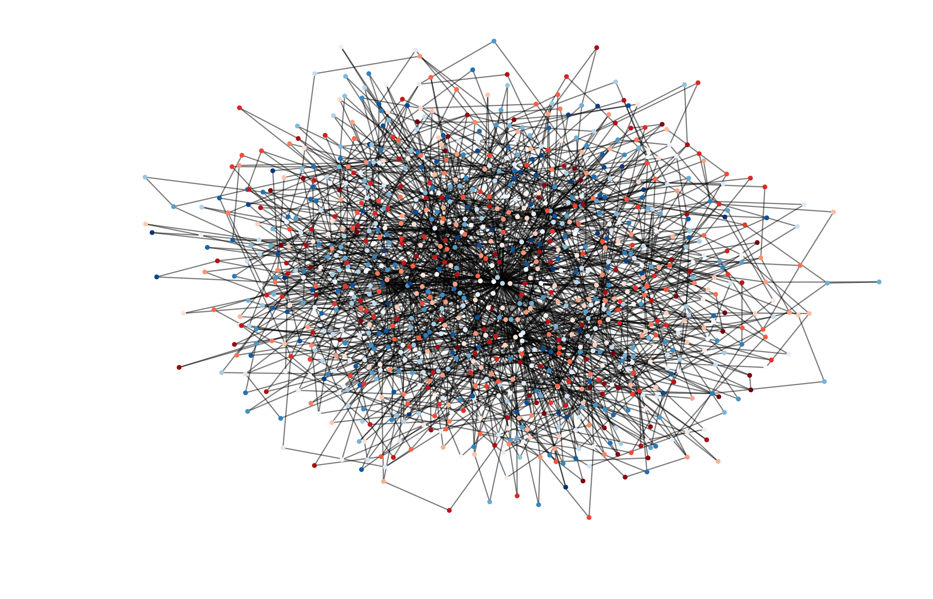
Stylized Facts
Network Initialization
Random

Slide 18
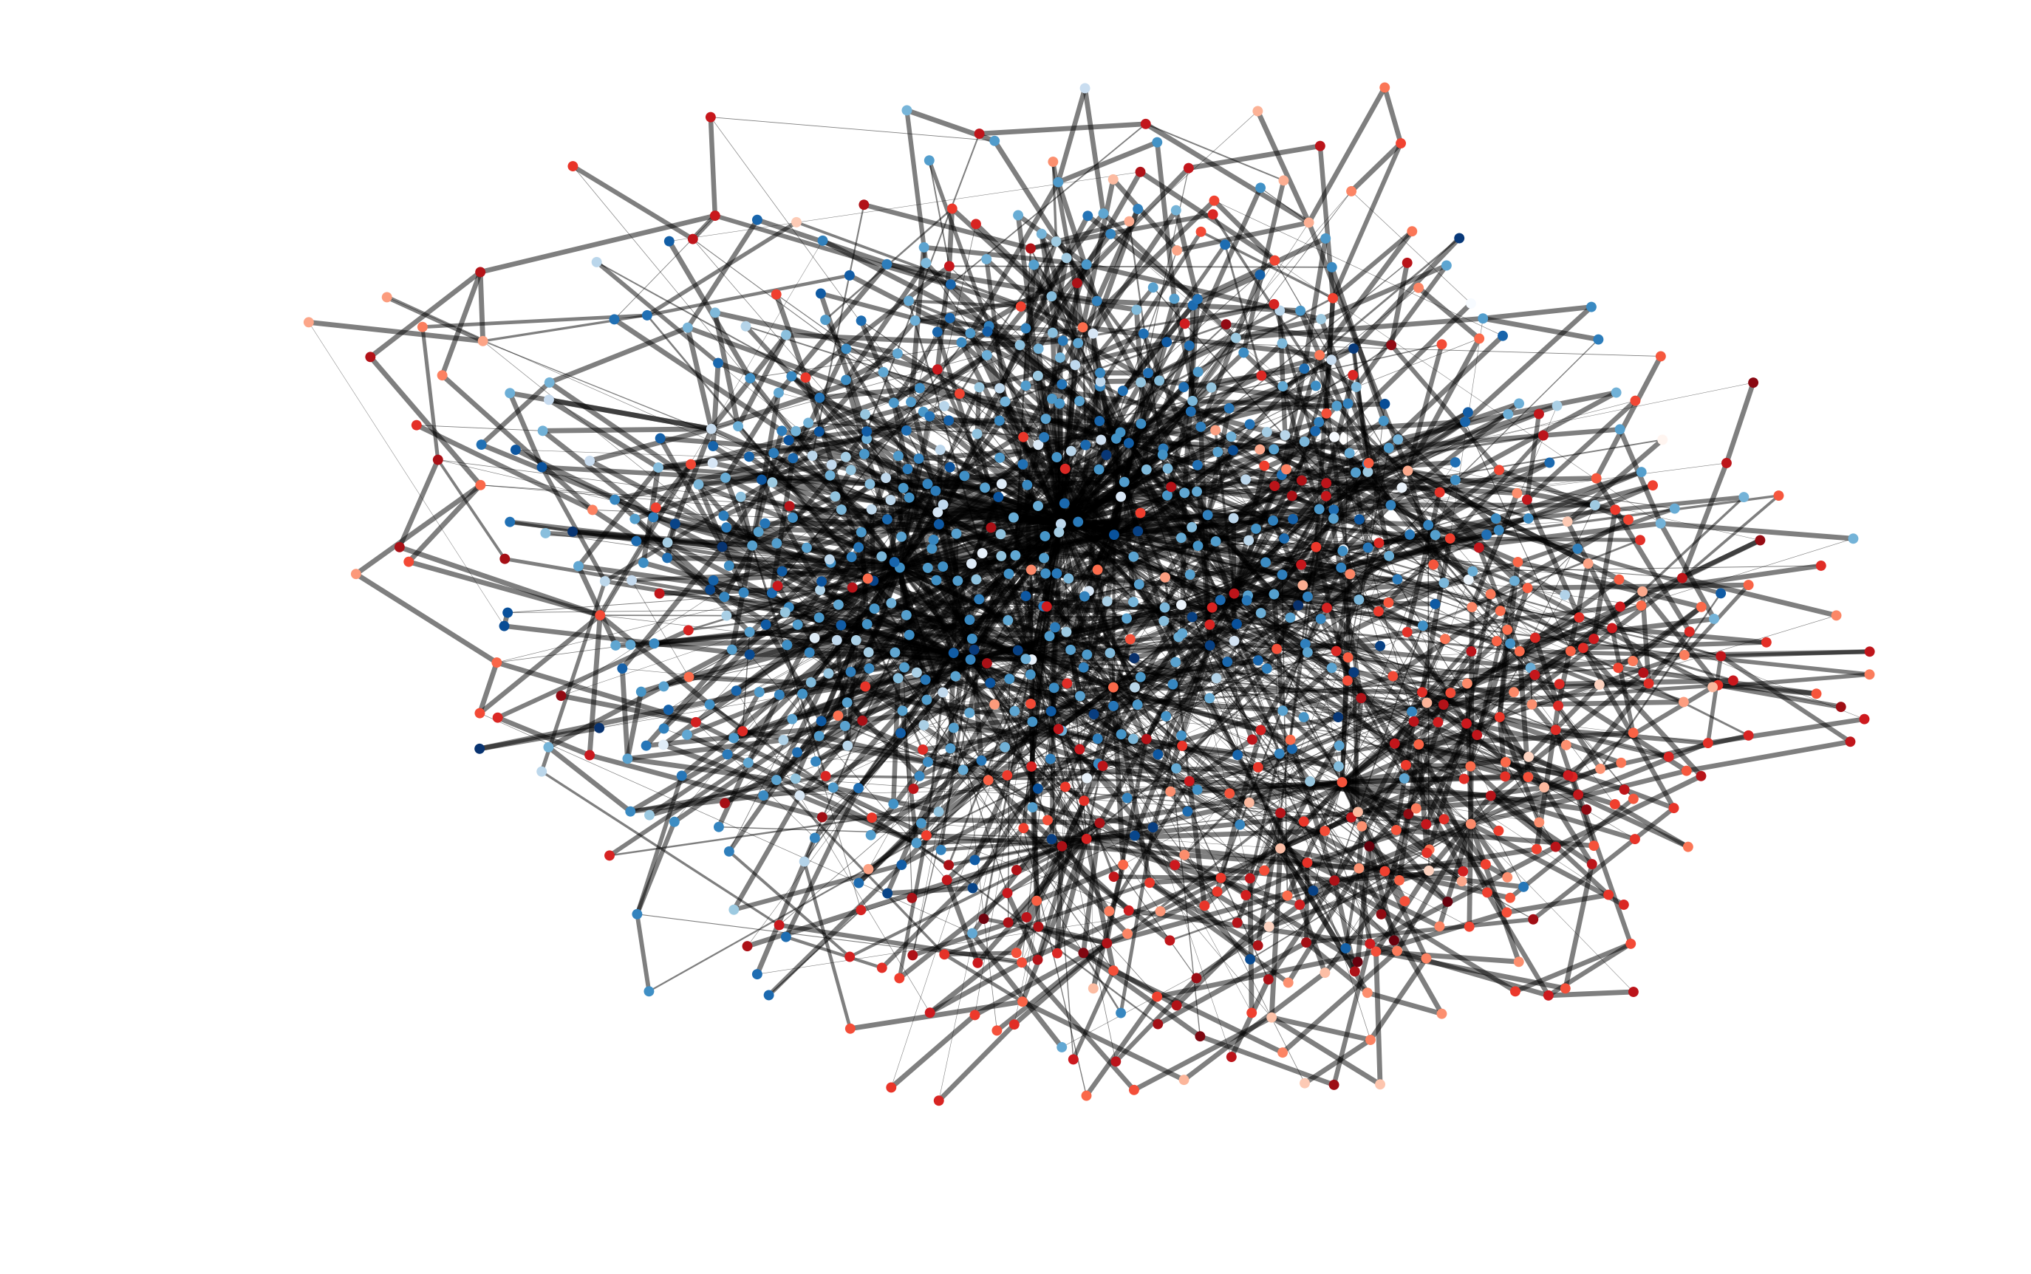
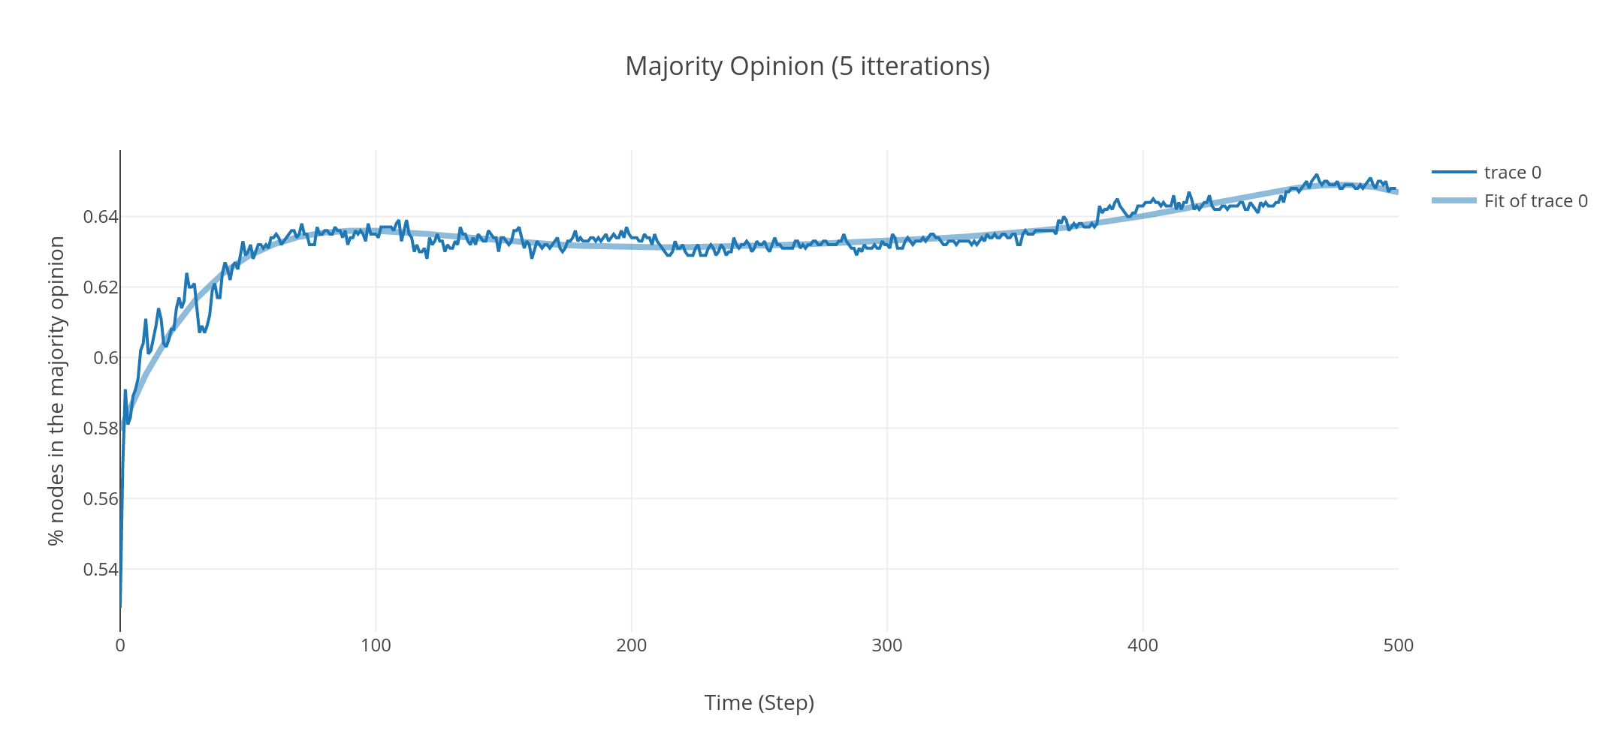
Stylized Facts (Majority Opinion)

Slide 19
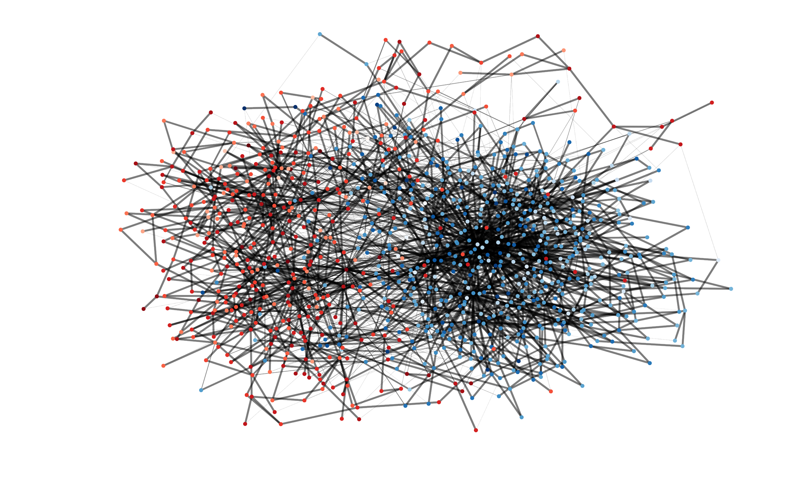
Stylized Facts (Radical Opinions)
Majority Opinion
Echo Chamber

Slide 20
Stylized Facts (Malicious Agent)
Malicious Agents: Influential Agent with bad intentions
The most connected Agent becomes malicious:
All Edges: 1.0
Own Preference: 1.0

Slide 21
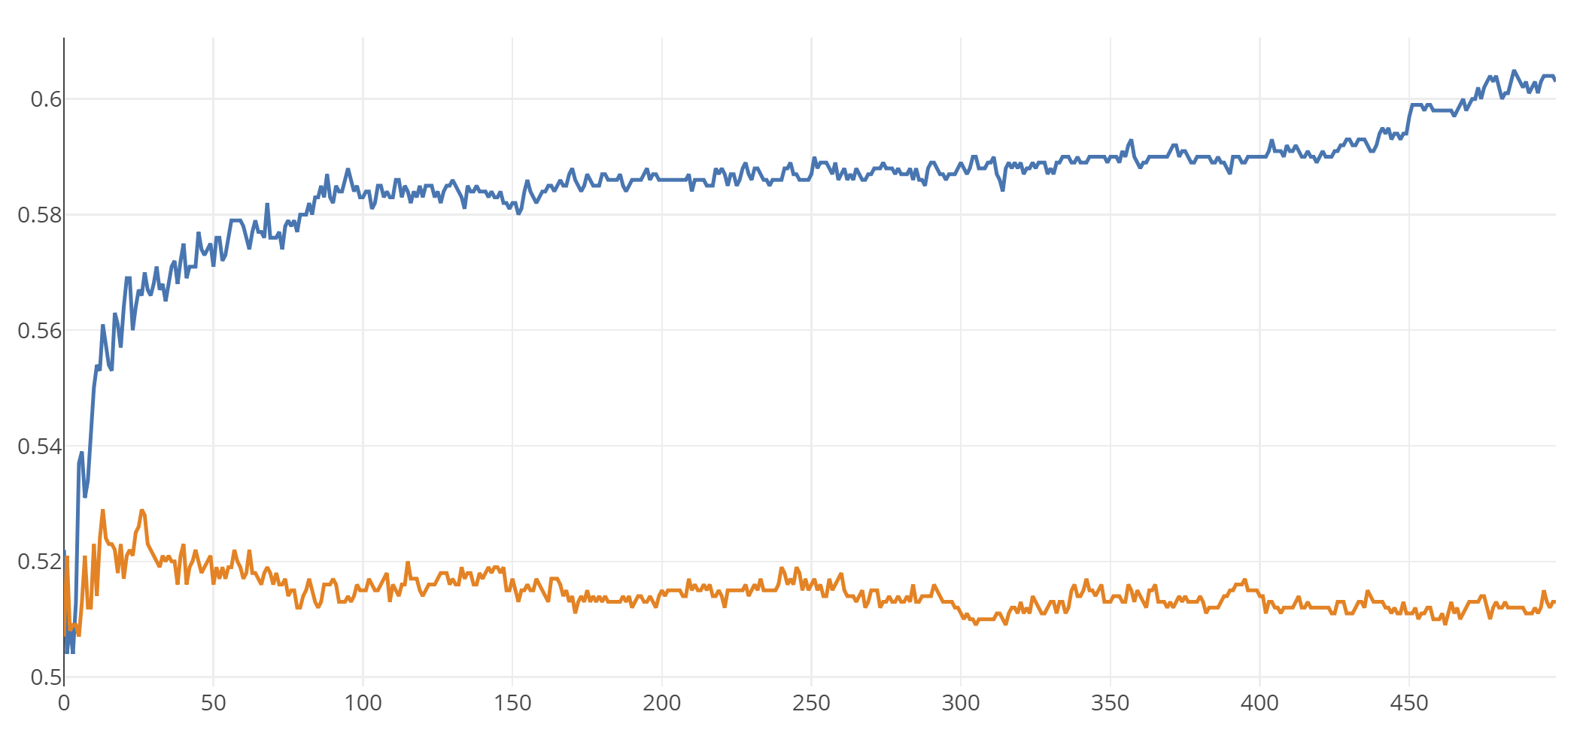
Stylized Facts (Malicious Agent)

Slide 22
Further Research
Look at how malicious agents influences the dynamics of the system
Minority majority distribution (Malicious agent’s influence on the opinion distribution)
The trust of agents in the system (do agents become less trustful as malicious agents are introduced)
Echo chambers (do malicious agents influence the amount of echo chambers)
Preferences of the minority and majority opinions

Slide 23
Questions?

